Slide 1
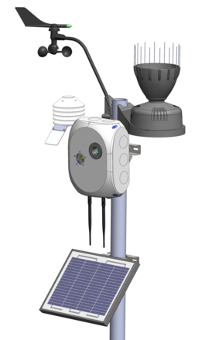
PhenoPiCam: CSAb (IG4)
PhenoPiCAm is an autonomous, low cost, solar-powered agricultural monitoring tool. The IoT system is based on the Rapsberry Pi computer board and incorporates a digital camera, meteorological sensors and data-logger to record plant development and record meteorological data to feed decision support models. It has clear economic and environmental benefits for growers in remote regions, helping them assess crop health remotely, optimise crop management applications and identify harvest time.
ROLE: EIT Climate-KIC co-funds and advises the PhenoPiCam via its Italian CSA hub
IMPACT: boosting resource efficiency, GHG emissions reductions & productivity in Italian wine production
STAGE: The current project will allow a real-world test of the PenoPiCam innovation developed by CNR-IBIMET and Edmund Mach Foundation.
SCALE: This project will enable the consortium to better understand the needs for remote wine growers in Trento and other EU countries.
Notes:
WINnERS’ outstanding research solves the problem for the World Food Programme, a major international food programme, in getting banks/multi-nationals to engage with smallholders without market access.
More than 50 percent of food and fibre supply chain disruptions are due to storms and droughts – something climate change is likely to exacerbate. Food supply chains and producers will need support to deal with climate change risks such as weather variability, planting seasons unpredictability or threats from pests and disease.
Insurance to date has been based on conventional climate risk assessments, which for agriculture,
mostly focus on average crop yield vulnerability in climate and adaptation scenarios.
These assessments are uncertain in projections over years and do not offer regional or local scale. For example, rain thresholds are established over a large geographical area based on historical rainfall patterns. In addition, micro insurance for adaptation purposes to date has focused only on the smallholder as the insurance policy holder and placing risk on the smallholders and the insurers. This has led to a failure in scaling up.
How the innovation works
WINnERS comprises five work streams across Climate Change and Extremes, Weather and Agriculture Risk, Contract Design, Rural Adaptation, Regulatory Framework. The work streams integrate multiple rainfall data sets, satellite monitoring, and predictions of the likelihood of extreme weather events to develop and design an insurance contract.
State-of-the-art weather and climate modelling technology measures the risk exposure that retailers, buyers, banks, and smallholder farmers will face in the future. At the farm level, the
likelihood of an extreme weather event and its severity can be predicted across areas as small as 5 x 5 km. This information is then integrated into agricultural insurance contracts that share risk between the various actors of a particular supply chain.
Weather-driven risk helps distribute producer risk across the supply chain – buyers are insured against price surges, farmers against price plunges, or banks against loss through re-insurance. Food cooperatives, banks, and food buyers—who are better able to manage and afford insurance – are the policy holders.
Naked Energy Ltd is an award winning British design and innovation company specialising in solar technology and energy conservation. The company is developing ‘Virtu’ ® a revolutionary and patented hybrid solar panel that generates both electricity and heat for commercial and industrial applications.
Naked Energy will be starting pilots in 2016 with support from DECC and the EIT. – watch this space.
Naked Energy claims its combination of photovoltaic cells in an evacuated tube collector results in higher electrical output and exceptional thermal performance.
NEED: Energy efficiency, renewable energy
MARKET: market ready
REGION: Manufacturing for customers in the UK, Europe and North America. End of last year the start-up inked an agreement with US-based manufacturing giant Jabil to scale up the production of its hybrid solar technology, Virtu.
PROPERTY TYPE: any?

